Slide 1
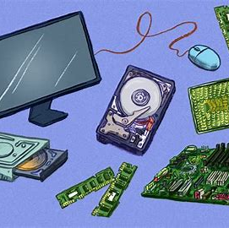
Computer hardware components

Slide 2
Computer Hardware:
Computer hardware is a physical device of computers that we can see and touch.
For eg:Monitor, CPU, Mouse, Joystick etc.
Using this devices, we can control computer operations like input and output.
The hardware components are divided into:
1: Input Unit
2:Output Unit
3:Internal Components
4:Storage Devices

Slide 3

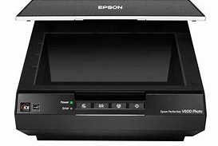
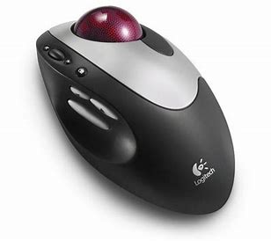

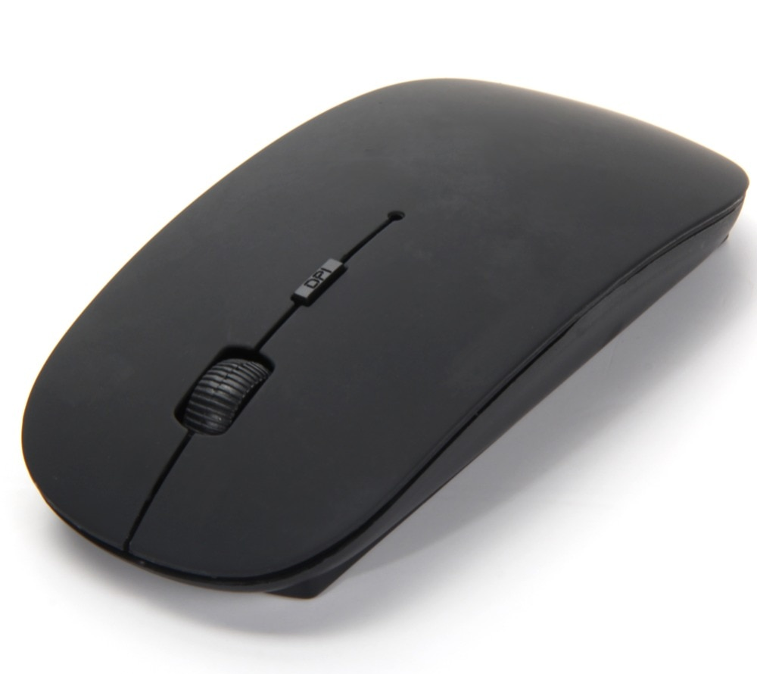
Input Devices:
Input devices are those devices with the help of which the user interacts with the computer
This information or data is accepted by the input devices and converted into a computer acceptable format, which is further sent to the computer system for processing.

Slide 4
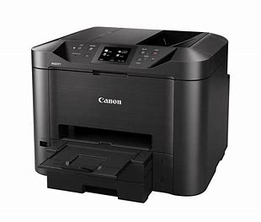
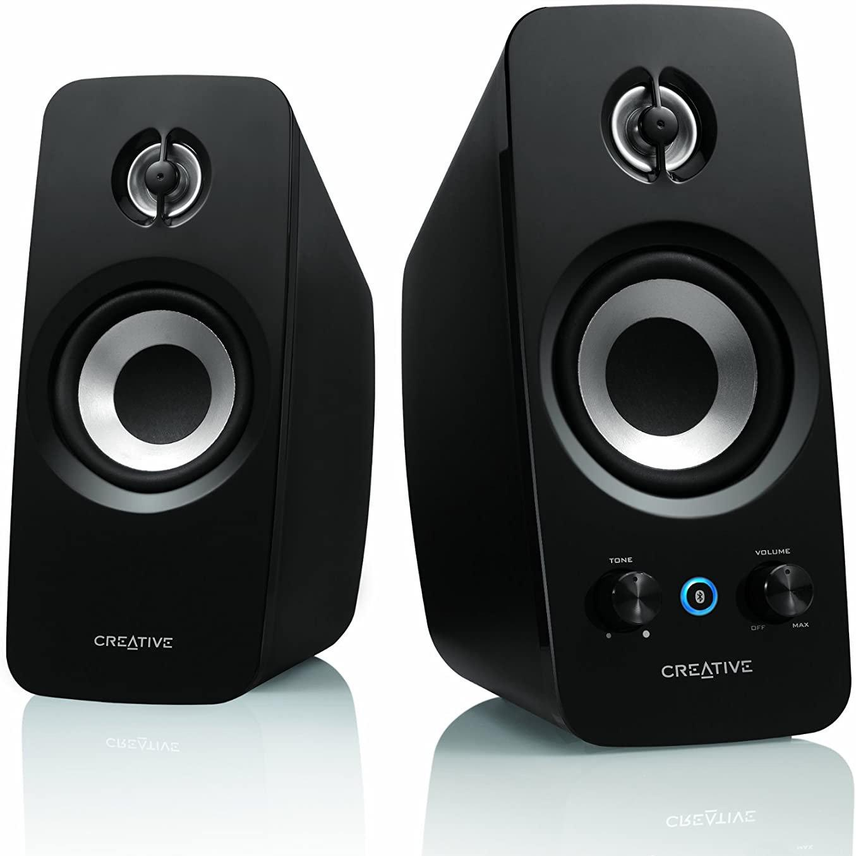
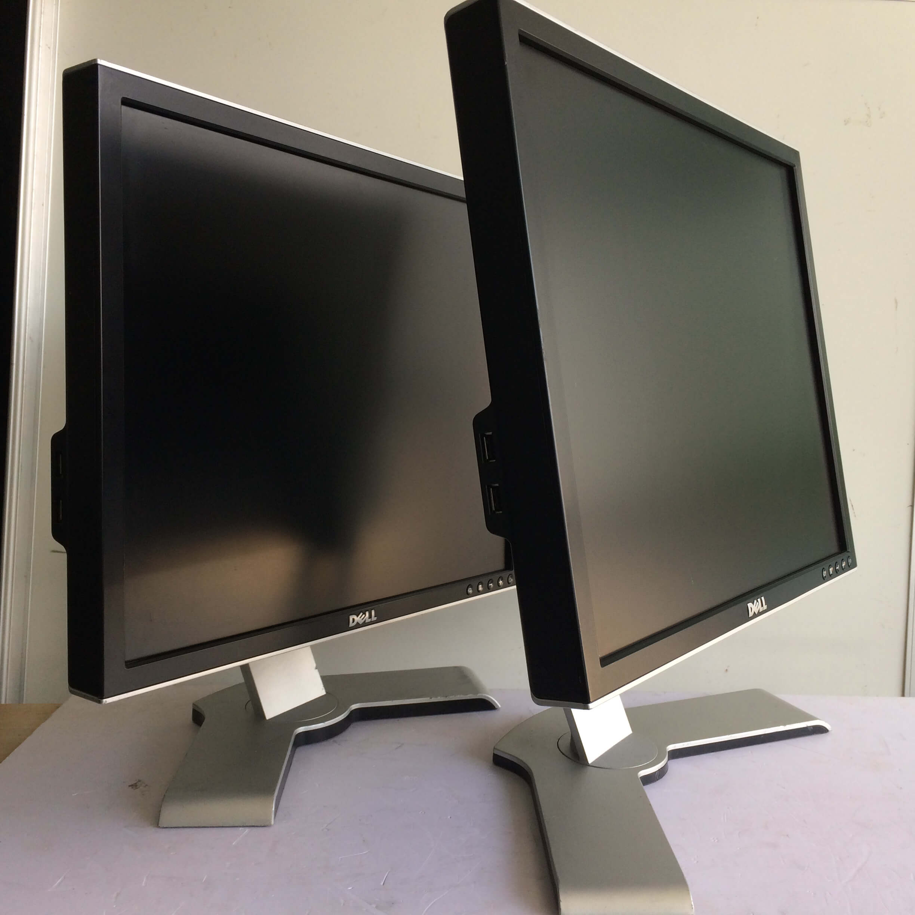
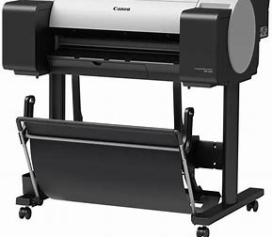
Output Devices
These are the devices that are used to display the output of any task given to the computer in human-readable form.

Slide 5
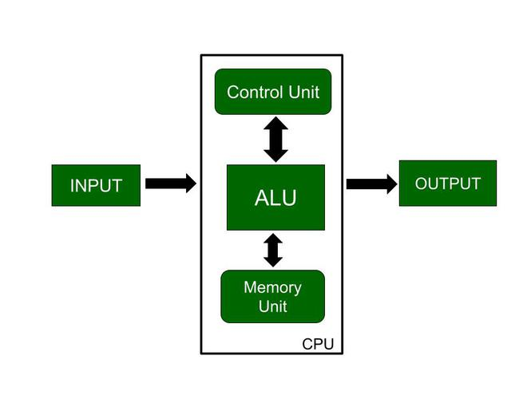
Internal Components:
CPU (Central Processing Unit): CPU is also known as the heart of the computer. It consists of three units, in general known as the control unit, Arithmetic Logical Unit (ALU), and the memory unit.
This input goes to memory and the control unit gets instructions from memory. Control unit now decide what to do with the input or instructions and transfer it to ALU.
Now, ALU performs various operations like addition, subtraction, multiplication, division, and logical operations, etc. After that, the final result gets stored in a memory and finally passed to output devices to give the output.
Block diagram of CPU

Slide 6
Memory Unit:
Two Types of memory Units are:
1: RAM
2:ROM
Random Access Memory(RAM):
It is Volatile. The program and data are stored in RAM.Two types are there 1)SRAM and 2)DRAM.
Read Only Memory(ROM):
It contains fundamental instructions that cannot be lost or changed by the user. It is nonvolatile.

Slide 7
Storage Devices:
There are some devices that are used for storage purposes and are known as secondary storage devices.
1. CD (Compact disc):
A CD is circular in shape and made up of thin platted glass and plastic polycarbonate material. It has a storage capacity of 600 MB to 700 MB of data. It has a standard size of 12 cm with a hole in the center of about 1.5 cm and 1.2 mm in thickness.
There are basically 3 types of CDs 1:CD-ROM 2:CD-R 3:CD-RW.
2. DVD(Digital Video/Versatile Disc):
A DVD is same as CD but with some more features. A DVD comes in single and dual-layer format. It has much greater storage capacity in comparison to CD. The storage capacity of a DVD with one sided single layer is – 4.7 GB, one sided double layer – 8.5 GB, double sided single layer – 9.4 GB, double sided double layer – 17 GB.
3. Hard Disk:
A hard disk is a non-volatile storage device that uses its read/write heads to store digital data on a magnetic surface of a rigid plate. It is generally 3.5 inches in size for desktops and 2.5 inches in size for laptops.
A hard disk can be classified further into 3 types:
1:Internal Hard Disk
2:Internal Cartridges
3:Hard disk Packs

Slide 8

Thank You

